Slide 1
Implementing Java Messaging Service (JMS) in JBOSS EAP

Slide 2
Concepts in JMS
Topics
In JMS a Topic implements publish and subscribe semantics.
When you publish a message it goes to all the subscribers who are interested (1-to-many model of distribution).
The same published message is received by all consuming subscribers (broadcast)
Queues
A single message will be received by exactly one consumer.
If there are no consumers available at the time the message is sent it will be kept until a consumer is available that can process the message.

Slide 3
Introduction
JMS is an API to create, send and read messages
Normal standalone JBOSS EAP will not give the JMS options
JBOSS EAP needs to be started using standalone-full.xml or standalone-fullha.xml based on your requirement

Slide 4
Contents covered
We will be covering
Creating a queue in JBOSS EAP using CLI
jms-queue add --queue-address=anyname --entries=queue/anyname,java:jboss/exported/jms/queue/anyname
Creating an application user with guest role to produce/consume the messages
Using a existing code to produce and consume from a queue
Testing the queue

Slide 5
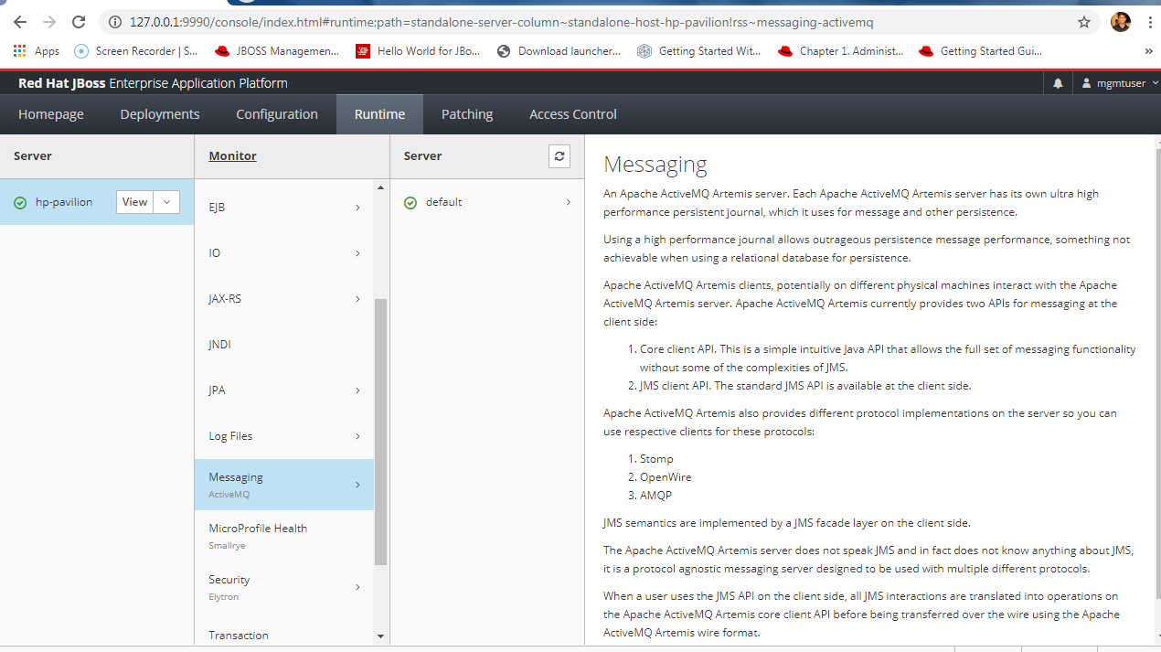
Runtime -> Messaging

Slide 6
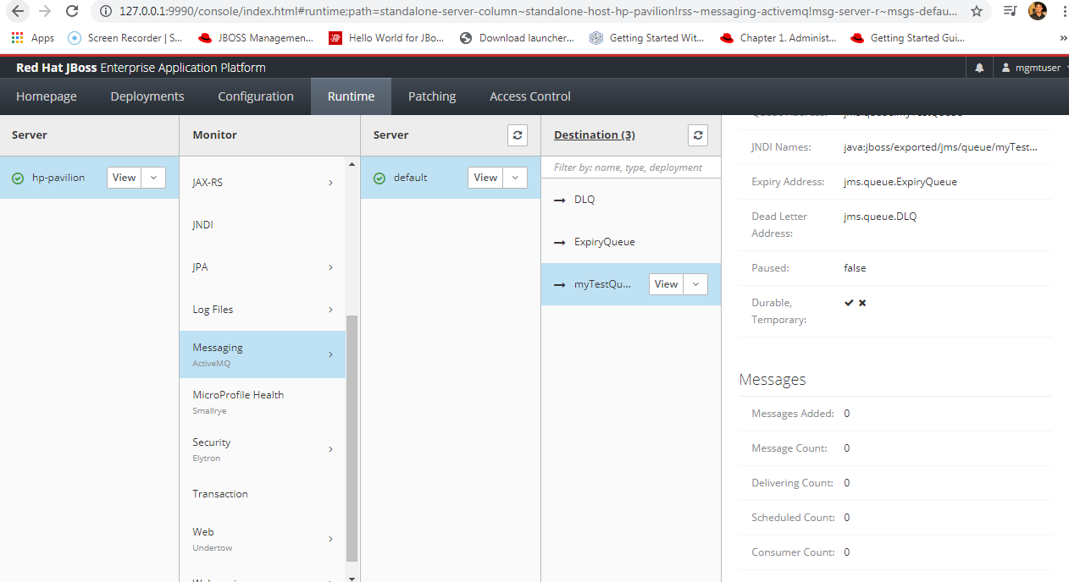
A sample queue

Slide 7
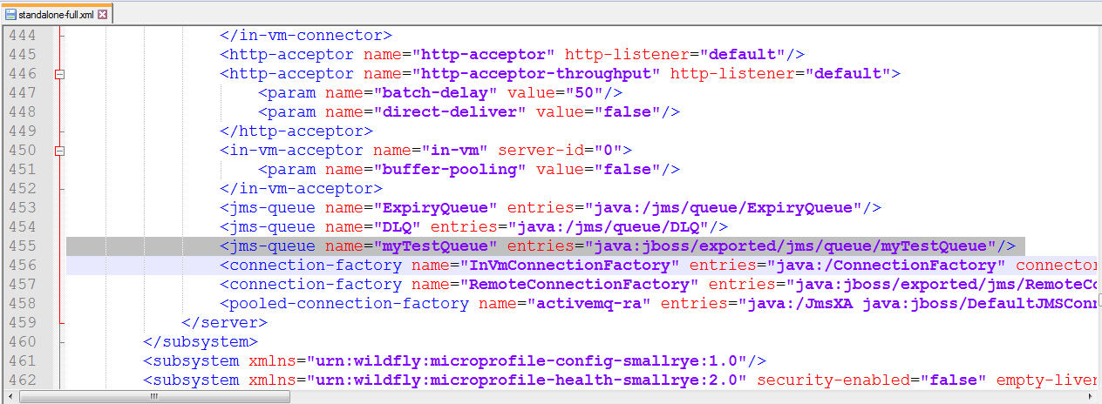
Queue showing up in Standalone-full.xml

Slide 8
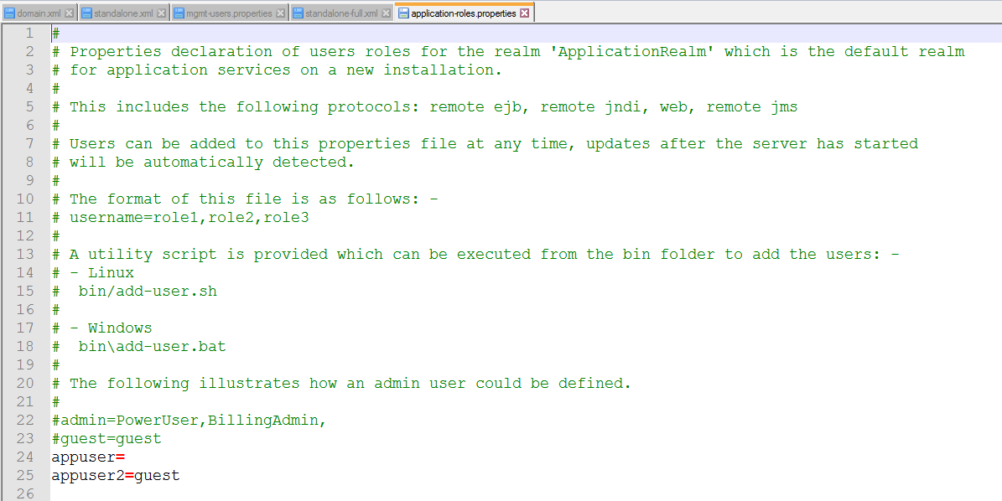

Slide 9
References
https://github.com/xcoulon/wildfly-quickstart/blob/master/helloworld-jms/src/main/java/org/jboss/as/quickstarts/jms/HelloWorldJMSClient.java

